Slide 1
eNGLISH 9 UNIT 7 : SAVING eNERGY GRAMMAR * CONNECTIVES * PHRASAL VERBS * SUGGESTIONS PERIOD : 47 TEACHER : HOÀNG DIỆP – DO VAN DAY secondary school

Slide 2
I. CONNECTIVES
but
because
and
CONNECTIVES
( Từ nối)
or
therefore
however
so

Slide 3
CONNECTIVES
* and – or
- and : và
Ex : - This appliance is modern and economical.
- His father is a doctor and he works in a hospital.
- or : hay , hoặc, nếu không
Ex : - Is it Tuesday or Wednesday today?
- Hurry up or you will be late for work

Slide 4
CONNECTIVES
* Because : bởi vì
I wanted to go home because I felt sick
I wanted to go home since I felt sick.
I wanted to go home as I felt sick.
Because/Since/ As I felt sick, I wanted to go home .

Slide 5
CONNECTIVES
*but – however : nhưng , tuy nhiên
Ex : He tried to read a book . He couldn’t understand it .
He tried to read a book, but he couldn’t understand it .
He tried to read a book ,however, he couldn’t understand it .
He tried to read a book ;however, he couldn’t understand it .
He tried to read a book .However, he couldn’t understand it .

Slide 6
CONNECTIVES
so – therefore : vì vậy , do đó
Ex : There is too much traffic. The air is polluted.
There is too much traffic, so the air is polluted.
There is too much traffic ,therefore, the air is polluted.
There is too much traffic ;therefore, the air is polluted.
There is too much traffic .Therefore, The air is polluted.

Slide 7
CONNECTIVES
Connectives are used to connect words , phrases, clauses, or sentences.

Slide 8
Exercise 1 : complete the sentences. Use the correct connectives
a. Mrs. Quyen bought corn, potatoes ………………….cabbages at the market. ( and / or )
b. She ran so fast, ……………...she missed the bus. (and/ but )
c. Nam got wet ………………..…he forgot his umbrella. ( so/ because )
d. Hoa failed her math test. ………………….., she has to do the test again.
( However / Therefore )
e. Do you live in the city …………………..in the country?
(and / or)
f. It’s raining, …………………….I can’t go to the beach. (so / therefore)
g. Ba’s hobbies are playing football …………….collecting stamps( and / or )
h. Na is very tired . ……….….., she has to finish her homework before she goes to bed. ( However / Therefore )
i. I must save energy ……………..the world” energy resources are limited . ( so/ since )

Slide 9
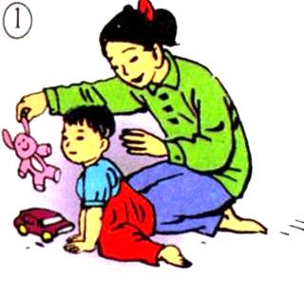
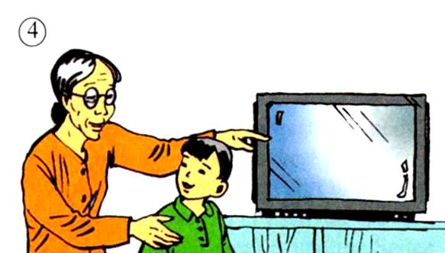
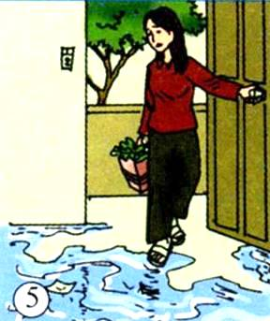
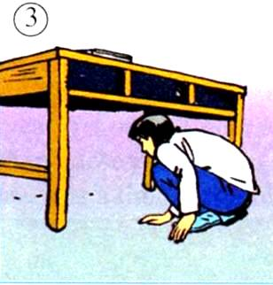
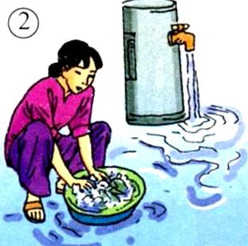
2.Phrasal verbs:
look after
turn on
turn off
chăm sóc
mở
tắt
look for
go on
tìm kiếm
tiếp tục

Slide 10
Complete the sentences. Use the right tense form of the phrasal verbs and the right pictures
turn on - turn off - look for - look after - go on
Hanh can’t go to the movies with us tonight. She will have to ………….. her little sister.
look after
go on
b) If we …….. wasting water, there will be a shortage of fresh water in a few decades.
Turn on
d) “ ………… the TV for me, will you? I want to watch the weather forecast.”
c) “I think I’ve lost my pen. I’ve ………….. it everywhere but I can’t find it anywhere.”
looked for
e) Mrs Yen forgot to …………… the faucet when she left for work.
turn off

Slide 11
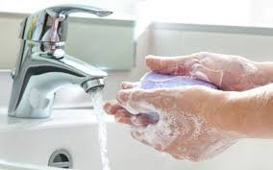
Should you wash your hand to avoid Corona virus?

Slide 12
III/ MAKE SUGGESTION
You should wash your hands
I suggest washing your hands
I suggest that you should wash your hands.
S + suggest + V-ing
S + suggest + (that) + S + should + V(bare)

Slide 13
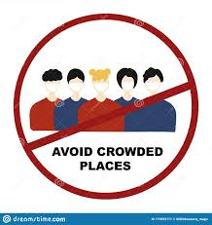
I + suggest +ving
Make suggestions, using the cues
wear masks in public
avoid crowed places
I suggest wearing masks in public
I suggest avoiding crowed places.

Slide 14
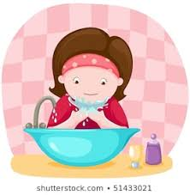
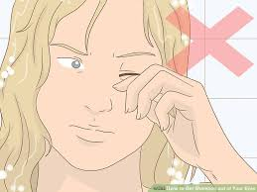
S + suggest + (that)+ s+ should + vo
avoid touching your eyes, nose and mouth
clear up her up personal space
I suggest that you should avoid touching your eyes, nose and mouth
I suggest that she should clear up her up personal space

Slide 15
b) Your friend wants to improve his/ her English. The following ideas may help you.
a. write sentences with new words
b. speak English in class
c. buy a good dictionary
d. do some reading everyday
I suggest writing sentences with new words
I suggest (that) you should speak English in class.
I suggest (that) you should buy a good dictionary.
I suggest doing some reading every day.

Slide 16
suggestions
Let’s + v0
Why don’t you +v0 ?
What about / How about + Ving ?
Shall we + v0 ?
I suggest + Ving …
I suggest that you should +V0……

Slide 17
1. Mary suggested going to the movies.
→ Mary suggested that
2. He suggested playing a game of chess.
→ He suggested that
3. Why don’t we go to the movies tonight?
→ How
4. We continue to hope that she will come.
→ We go
5. She failed the test, so she’ll have to do it again.
→ Since
6. I was tired. However, I had to finish my work.
→ I had to
7. It’s raining, so I can't go to the beach.
→ I can't
8 . Lan was late because she walked all the way to school.
→ Lan walked
we should go to the movies
we should play a game of chess
about going to the movies tonight?
on hoping that she will come
she failed the test, she’ll have to do it again
finish my work but I was tired
go to the beach because it’s raining
all the way to school, so she was late

Slide 18
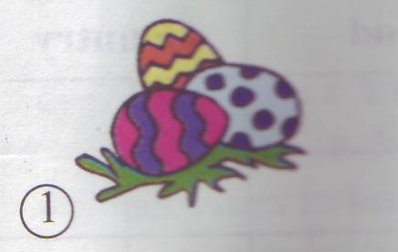
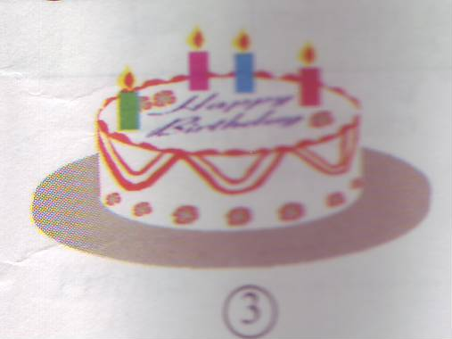
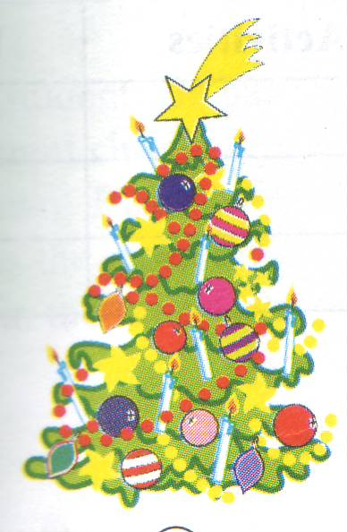
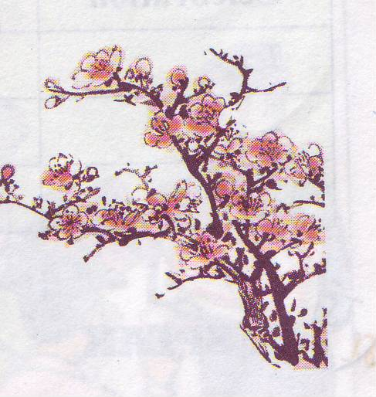
Unit 8: Celebrations
Lesson 1: Getting started – Listen and read
PERIOD :48
Easter
wedding
birthday
Easter
Lunar New Year
6
4
5
Christmas
birthday
Mid-Fall Festival
wedding
Christmas
Mid-Fall Festival
Lunar New Year

Slide 19
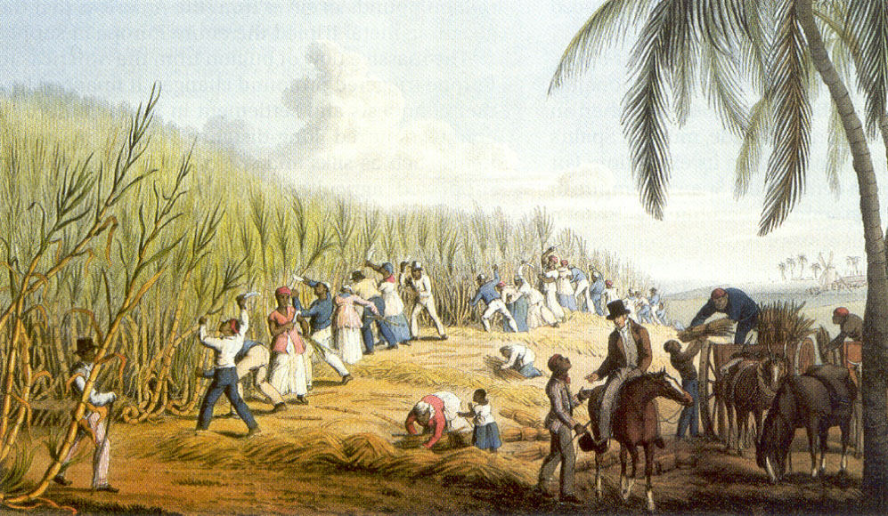
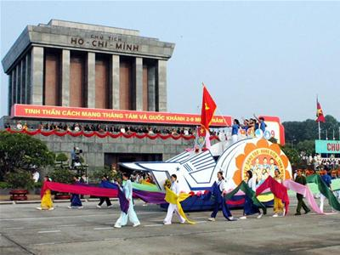
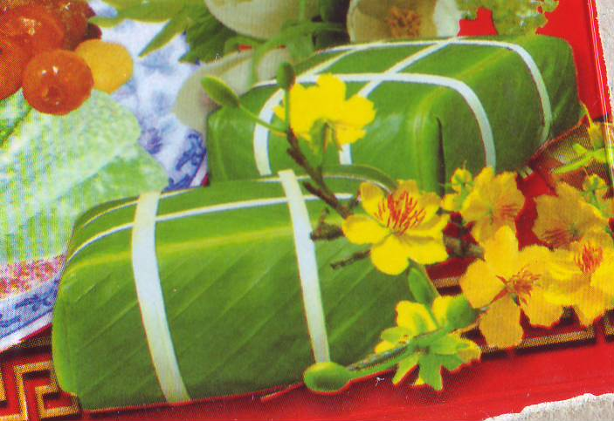
I. New words:
1. celebration (n) / celebrate (v):
lễ kỉ niệm
2. decorate (v)/ decoration (n):
trang trí
3. occur (v) = happen:
xảy ra
4. slavery (n) :
sự nô lệ
5. sticky rice cake :
bánh chưng
6. parade (n) :
cuộc diễu hành
7. live apart (v):
sống xa nhau
8. freedom (n):
sự tự do
9. joyful (a):
vui mừng
10. ancient (adj):
cổ xưa

Slide 20
Matching:
1. celebrate (v)/ celebration (n):
xảy ra
2. decorate (v)/ decoration (n):
sự tự do
3. occur (v) :
sự nô lệ
4. slavery (n) :
cổ xưa
5. sticky rice cake :
sống xa nhau
6. parade (n) :
trang trí
lễ hội
7. live apart (v):
bánh chưng
8. freedom (n)
vui mừng
9. joyful (a):
cuộc diễu hành
10. ancient (adj)

Slide 21
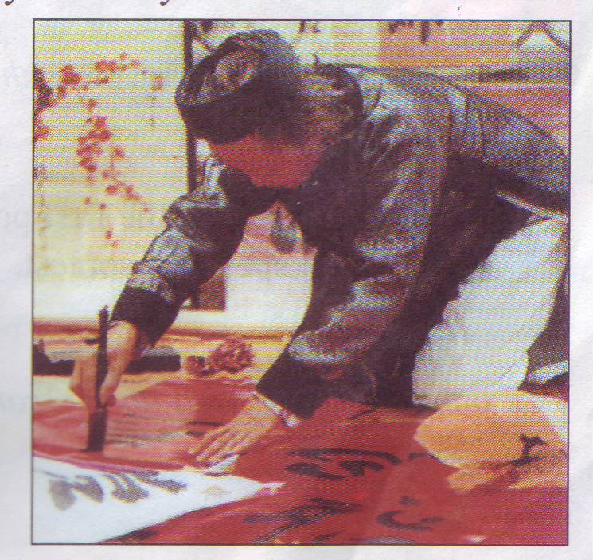
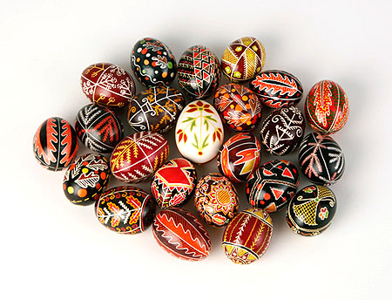
Unit 8. Celebrations
Lesson 1: Getting started - Listen & read
* Listen and read _ P. 65 - 66
How many celebrations does the text talk about?
→ The text talks about 03 celebrations.
2. What are they?
→ They are Tet or Lunar New Year, Passover and Easter.
Tet or
the Lunnar New Year
Passover
Easter

Slide 22
Open your book _P65-66
Although there are many celebrations throughout the year, Tet or the Lunar New Year holiday is the most important celebration for Vietnamese people. Tet is a festival which occurs in late January or early February. It is a time for families to clean and decorate their homes, and enjoy special food such as sticky rice cakes. Family members who live apart try to be together at Tet.
Passover is in late March or early April. This festival is celebrated in Israel and by all Jewish people. On this festival, people celebrate freedom from slavery. Passover is also an ancient spring festival. On the first and second nights of Passover, Jewish families eat a special meal called the Seder.
Easter is a joyful festival which is celebrated in many countries. It happens at around the same time as Passover. On Easter day (Easter Sunday), young children receive chocolate or sugar eggs – as long as they are good. In many countries, people crowd the streets to watch colorful parades.

Slide 23
Unit 8. Celebrations
Lesson 1: Getting started - Listen & read
I. New words.
II. Structure:
a. Tet is a festival
occurs in late January or early February.
which
which
Tet is a festival
. The festival
occurs in late January or early February.
b. Family members
who
live apart
try to be together at Tet .
who
Family members
live apart
. They
try to be together at Tet .
which, who: là ®¹i tõ quan hÖ (relative pronoun) dùng để thay thế cho một danh từ hay một đại từ
Which: thay cho tõ chỉ sự vật, sự việc
Who: thay cho tõ chỉ người

Slide 24
Homework:
Read the text again
Learn by heart new words
Find more information about Relative Pronouns (Đại từ liên hệ)
Prepare for the next lesson:
Speak _Listen P 66 – 67
Read

Slide 25
The End

